Slide 1
The new MyLeasePlan
Coming February 2021

Slide 2
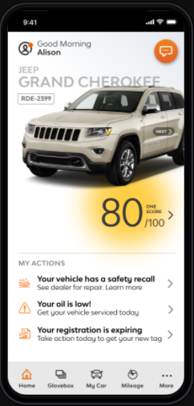
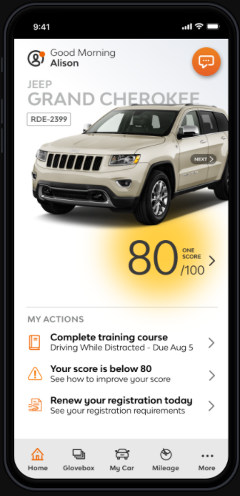
The MyLeasePlan mobile app helps drivers more easily manage their fleet vehicle. In 2021, LeasePlan is launching a new version – completely redesigned with drivers in mind.
With enhanced notifications and alerts, communicating just-in-time information, it’s now easier for a driver to know if they have tasks to complete – like getting maintenance, uploading documents for registration renewal, picking up a new vehicle, or reporting personal miles.
It’s also easier for drivers to look up statuses, or access registration or insurance cards with the new Glove Box. Lost vehicle maintenance guide? No problem. It’s stored there, too. Prefer touchless service? Get maintenance authorization details from the Service My Vehicle section – no paper Vehicle Maintenance Guide needed.
Introducing the
new-and-improved
MyLeasePlan
01
02
04
03
agenda

Slide 3
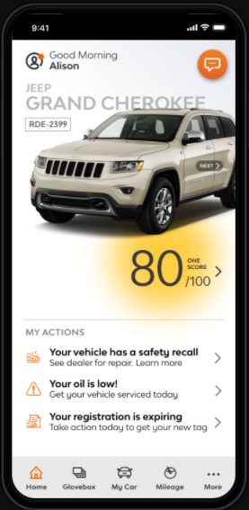
Access your profile
Get virtual assistance with Elle
Find out how you rank with OneScore
Easily close the loop on tasks
New
look.
New experience.
Simplified mileage reporting
Navigation made easier with the new menu bar
01
02
04
03
agenda

Slide 4
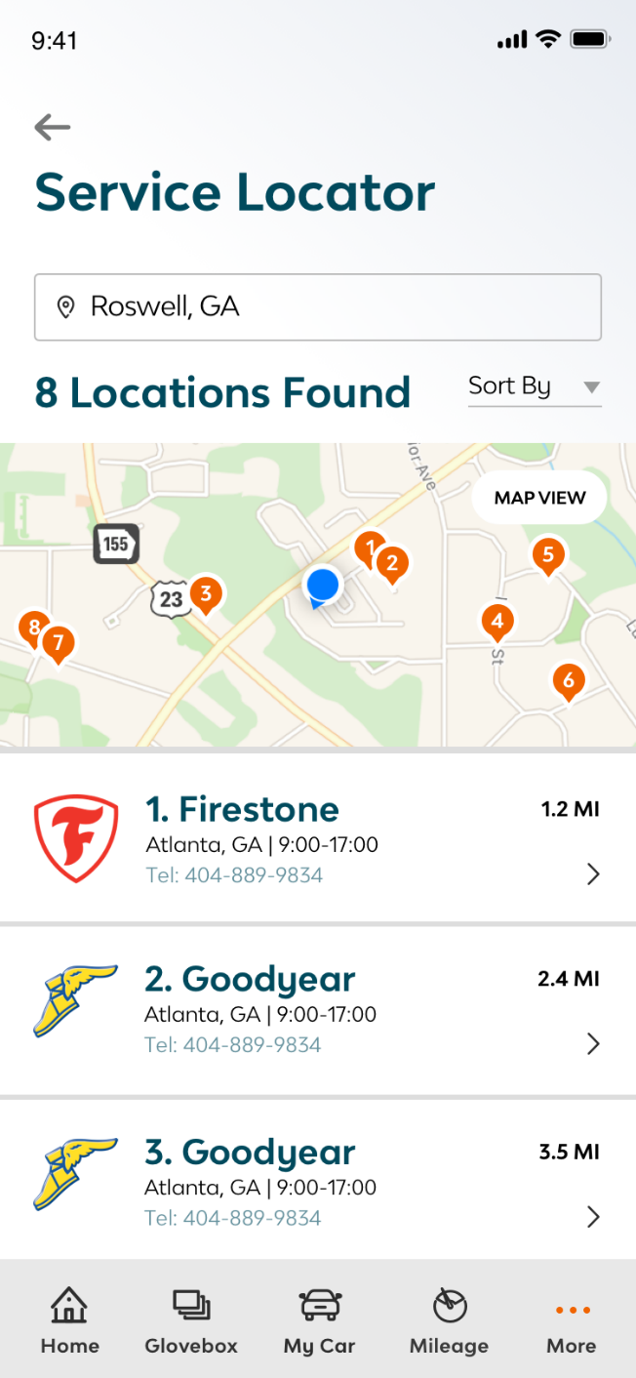
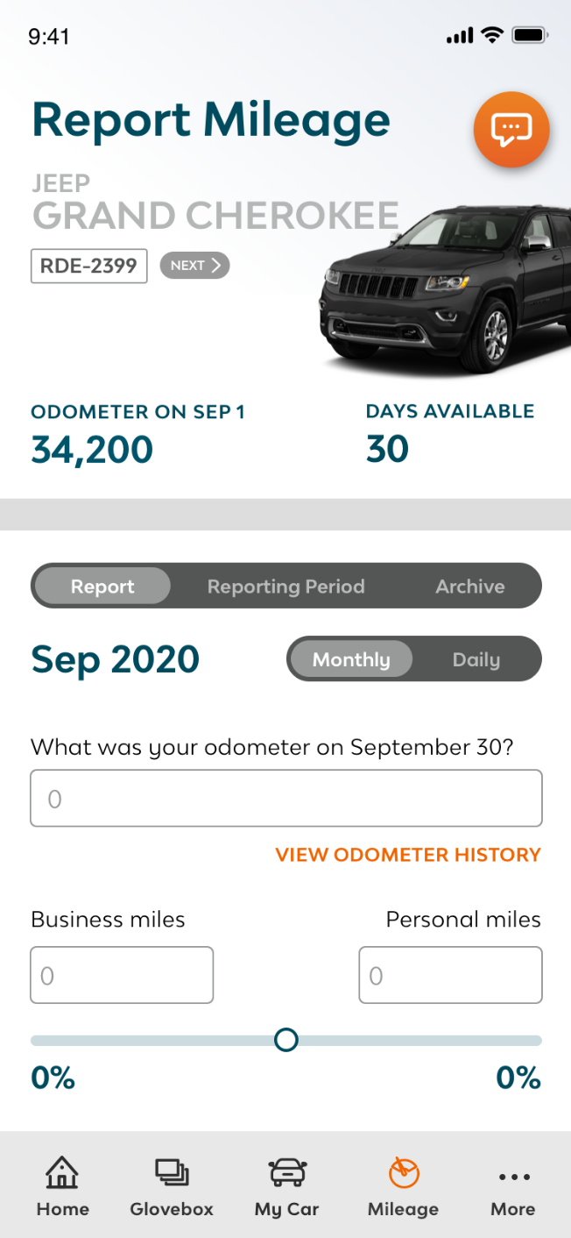
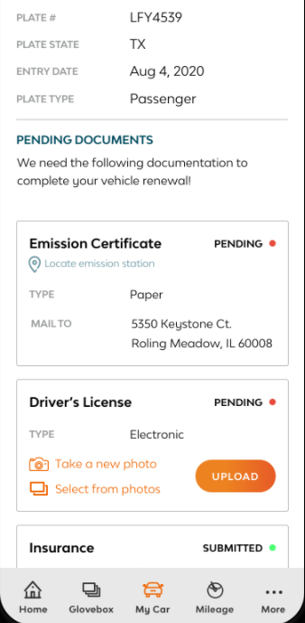
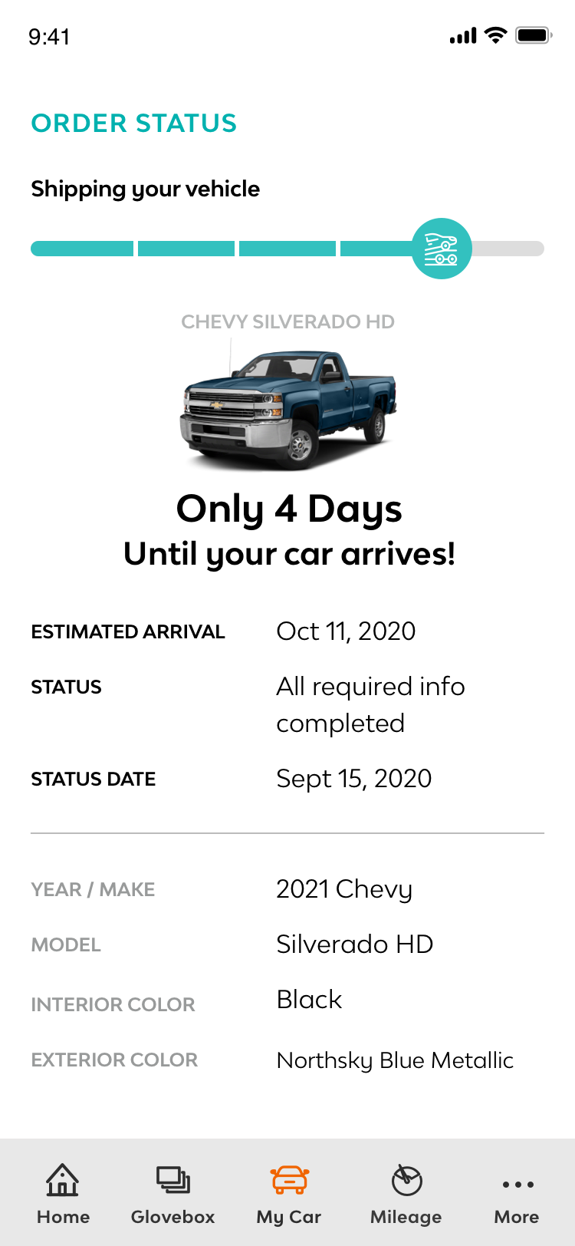
Upload documents for renewals
View order status and report pickup of a new vehicle
More easily find National Account providers
More intuitive mileage reporting
Empowering drivers.
Saving them time.
01
02
04
03
agenda

Slide 5
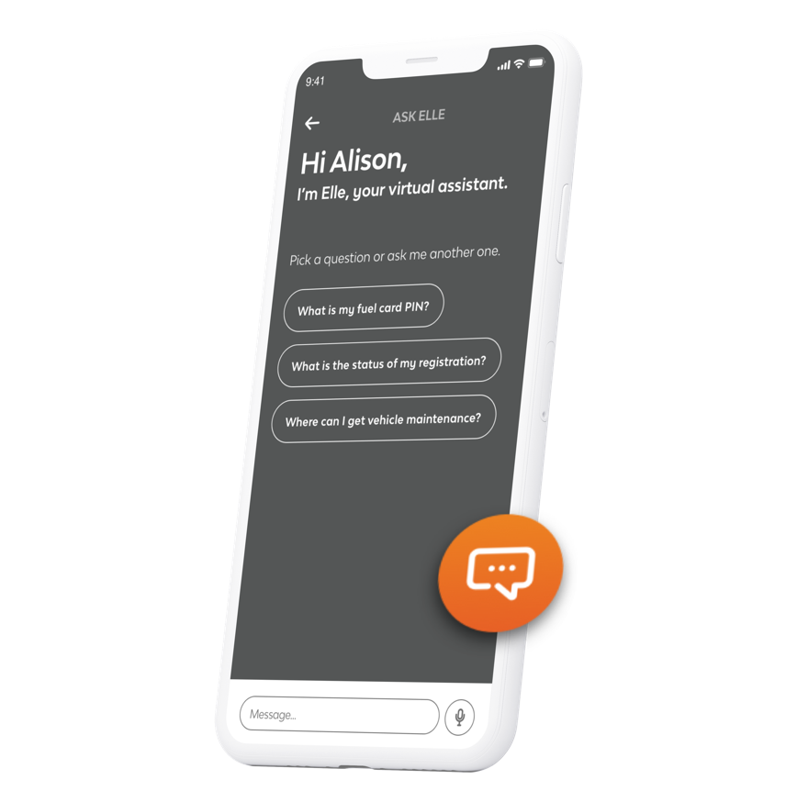
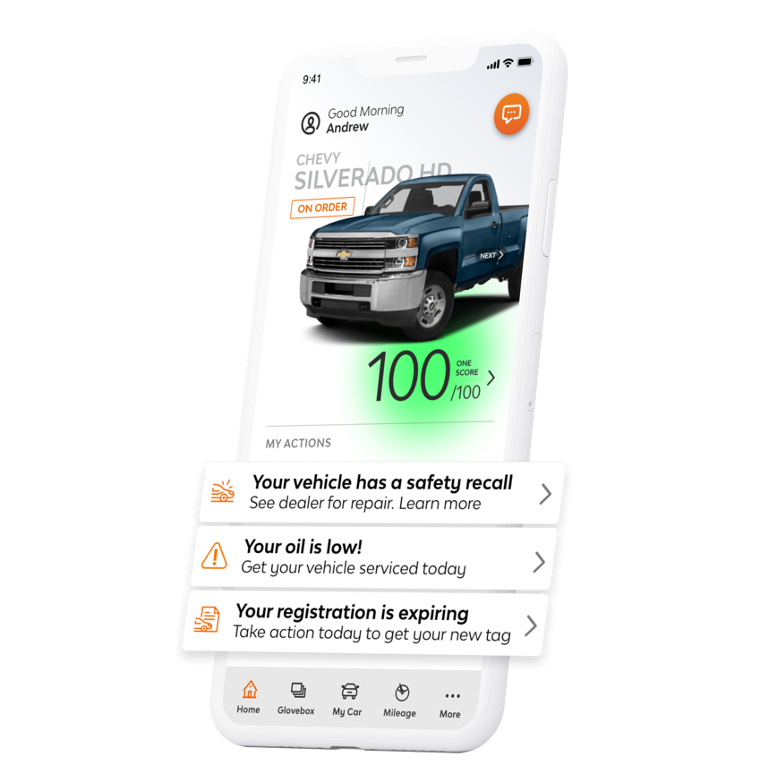
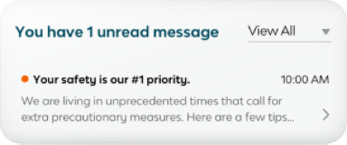
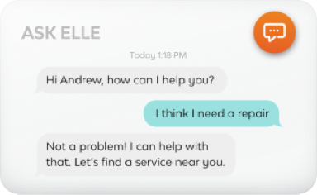
Get quick answers from virtual assistant Elle
Get in-app notifications for tutorials and immediate actions
Multiple touchpoints.
One single app.
01
02
04
03
agenda

Slide 6
Completely redesigned UI for effortless driver experience
Device integrated push notifications for Immediate Actions
Simplified, intuitive mileage reporting and odometer history
Enhanced new vehicle delivery form to include temporary plate information and dealer survey
Vehicle order status progress bar with major milestones and additional status detail
Registration renewal status and document upload process
Key vehicle functions consolidated under My Car
Glovebox for key document retrieval, uploading and storage
Open recall notifications and repair reporting
Pool driver VIN scanning for trip management
Company policy review and acceptance
Elle prepopulated questions and knowledge expansion, including registration renewal status
Enhanced in-app communications from LeasePlan – carousels, tutorials, notification box
New features
01
02
04
03
agenda

Slide 7
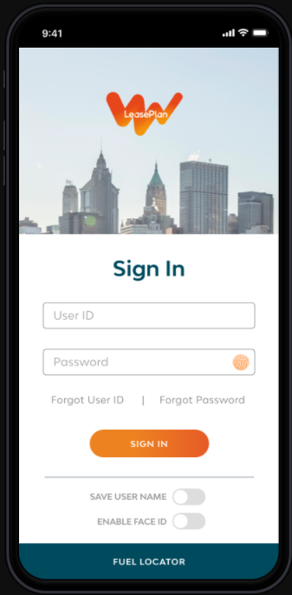
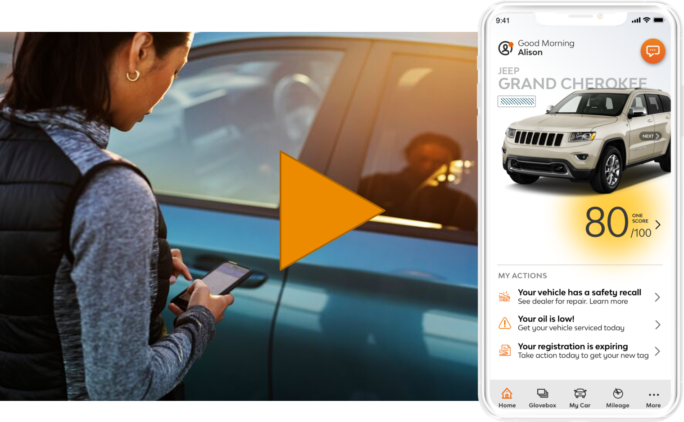
Have you seen the MyLeasePlan video?
Take a look at the new features.

